Slide 1
Module I: Introduction to Cloud Computing
Dr. Madhukrishna Priyadarsini
Department of CSE
NIT Trichy

Slide 2
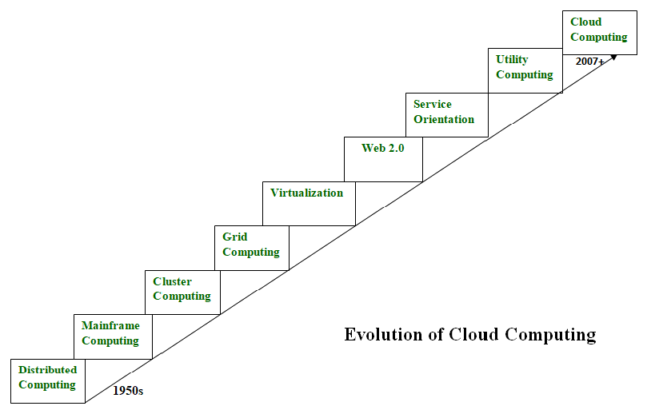
Evolution:

Slide 3
Definition of Cloud Computing
The term ‘cloud’ is defined by NIST [10] as follows:
“Cloud computing is a model for enabling ubiquitous, convenient, on-demand network access to a shared pool of configurable computing resources (e.g., networks, servers, storage, applications, and services) that can be rapidly provisioned and released with minimal management effort or service provider interaction. This cloud model is composed of five essential characteristics, three service models, and four deployment models.”

Slide 4
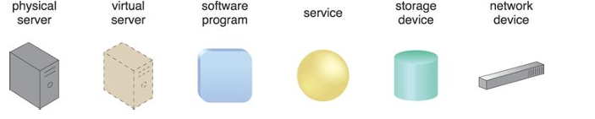
Basic Concepts:
Cloud
IT Resources
On-premise: An IT resource that is hosted in a conventional IT enterprise within an organizational boundary

Slide 5
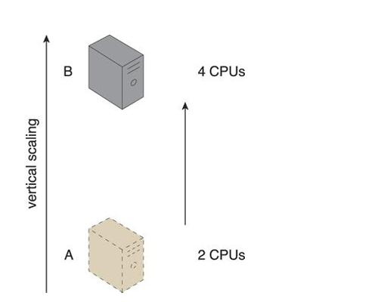
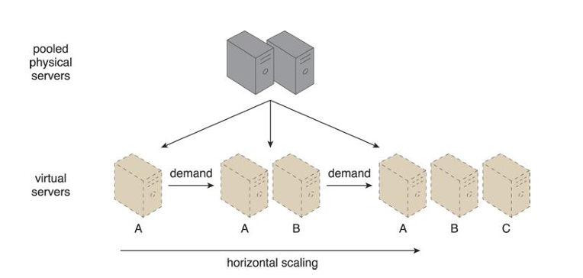
Cloud consumers and providers
Scaling

Slide 6
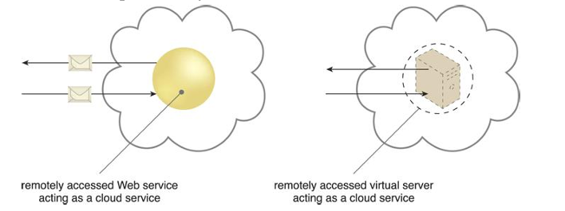
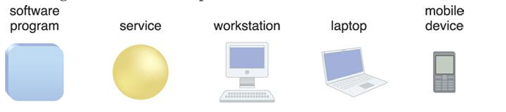
Cloud services
Cloud service consumers

Slide 7
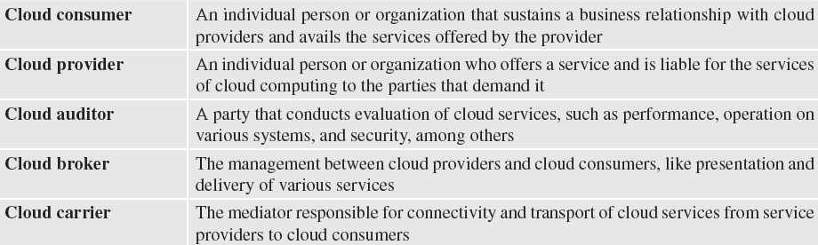
Terminology used in Cloud Computing

Slide 8
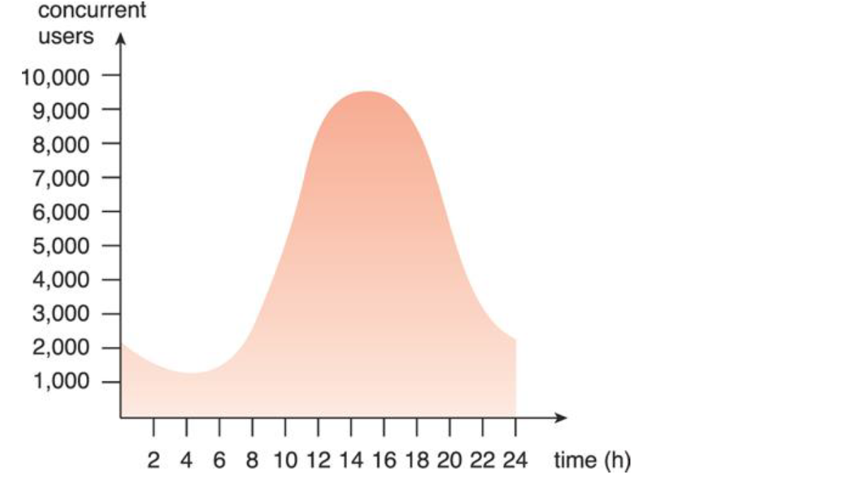
Benefits:
Reduced Investments and Proportional Costs
On-demand access to pay-as-you-go computing resources on a short-term basis (such as processors by the hour), and the ability to release these computing resources when they are no longer needed.
The perception of having unlimited computing resources that are available on demand, thereby reducing the need to prepare for provisioning.
The ability to add or remove IT resources at a fine-grained level, such as modifying available storage disk space by single gigabyte increments.
Abstraction of the infrastructure so applications are not locked into devices or locations and can be easily moved if needed.
Increased Scalability

Slide 9
Increased Availability and Reliability
• An IT resource with increased availability is accessible for longer periods of time (for example, 22 hours out of a 24 hour day). Cloud providers generally offer “resilient” IT resources for which they are able to guarantee high levels of availability.
• An IT resource with increased reliability is able to better avoid and recover from exception conditions. The modular architecture of cloud environments provides extensive failover support that increases reliability.

Slide 10
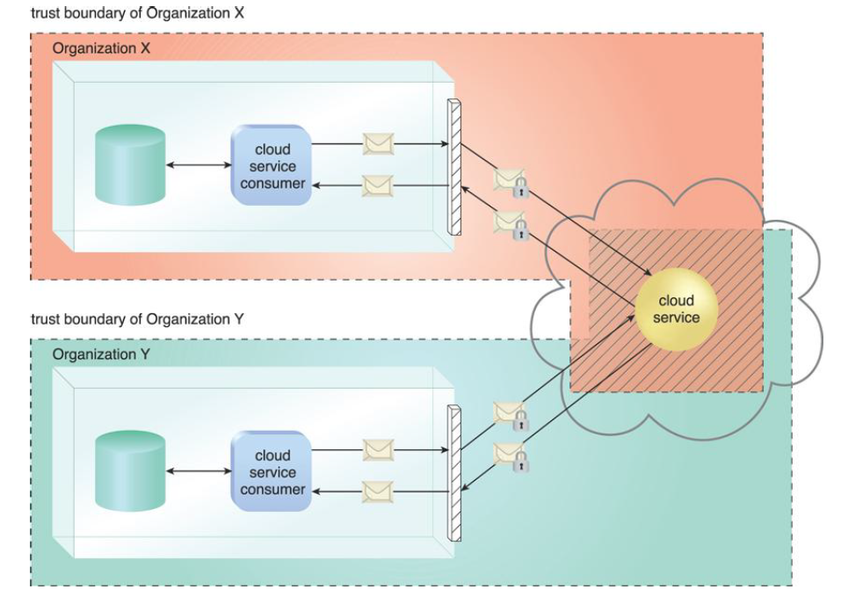
Risks and Challenges:
Increased Security Vulnerabilities

Slide 11
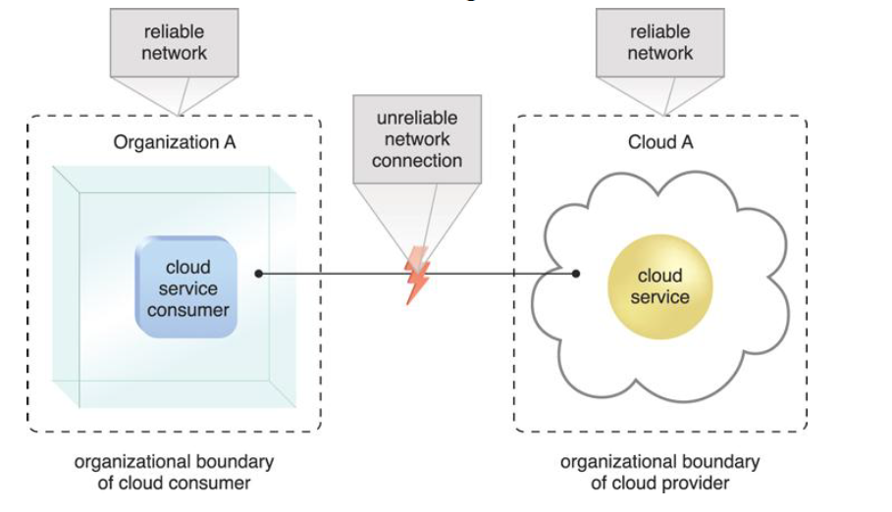
Reduced Operational Governance Control

Slide 12
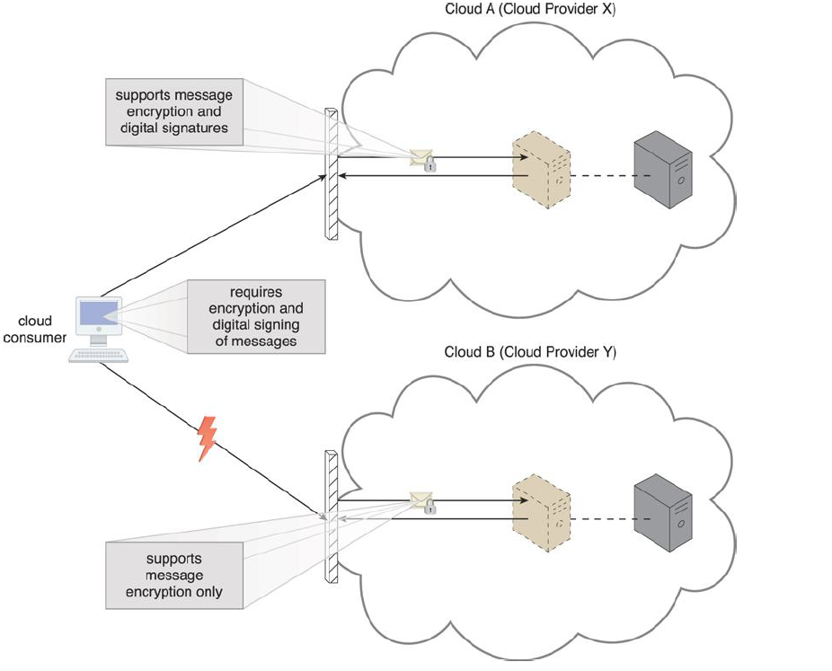
Limited Portability Between Cloud Providers

Slide 13
Multi-Regional Compliance and Legal Issues
Serious legal concerns pertaining to industry or government regulations that specify data privacy and storage policies.
Another potential legal issue pertains to the accessibility and disclosure of data.
Most regulatory frameworks recognize that cloud consumer organizations are ultimately responsible for the security, integrity, and storage of their own data, even when it is held by an external cloud provider.

Slide 14
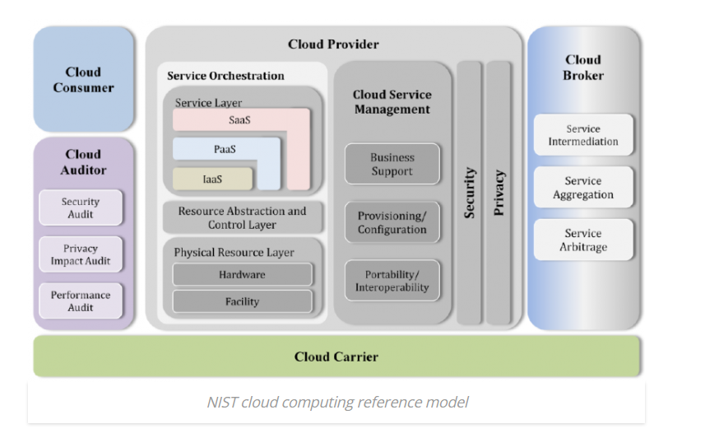
Roles

Slide 15
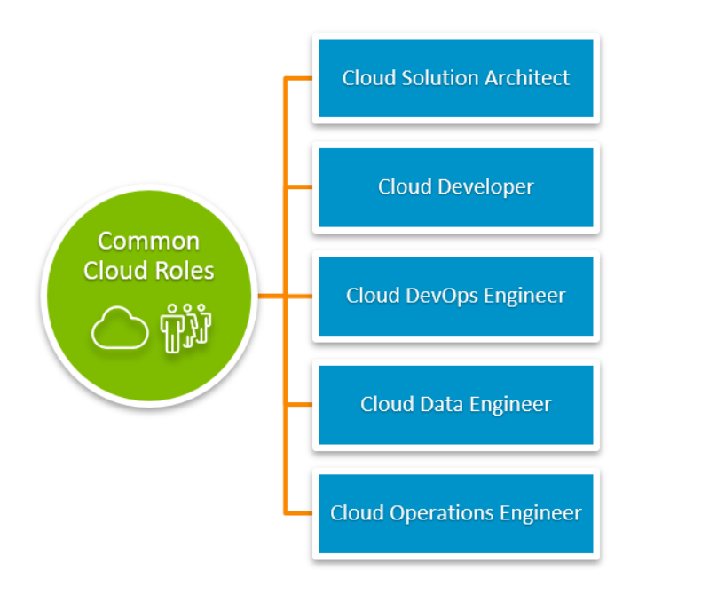
Job Roles in Cloud Computing

Slide 16
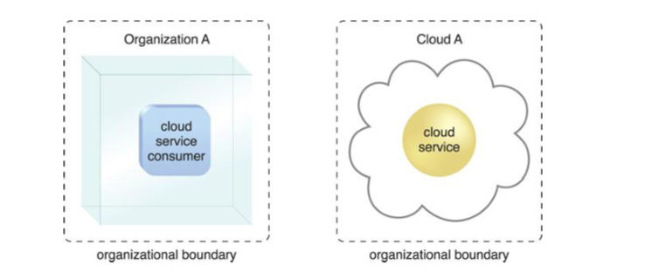
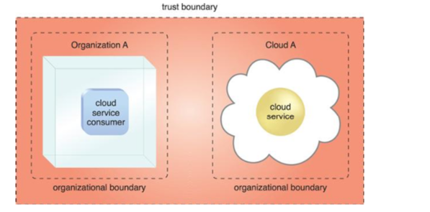
Boundaries:
Organizational boundary:
Trust boundary:

Slide 17
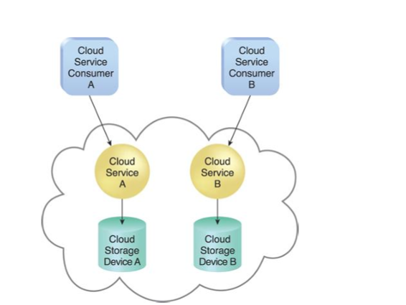
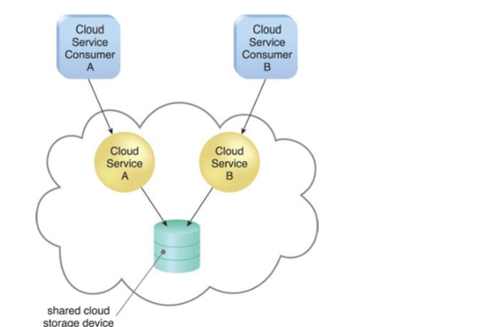
Characteristics
• On-demand usage
• Ubiquitous access (widely accessible)
• Multitenancy (and resource pooling)

Slide 18
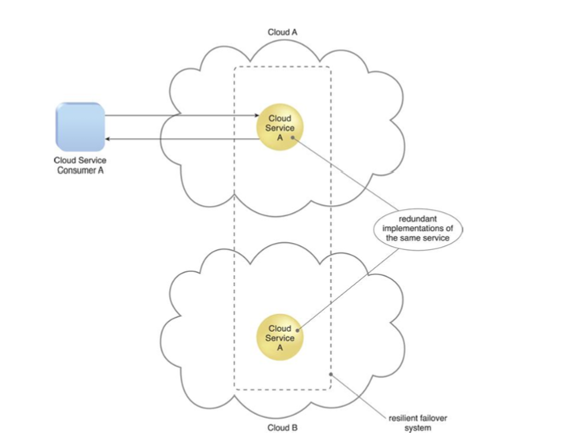
• Elasticity (Scaling of IT resources in run-time)
• Measured usage (ability of a cloud platform to keep track of the usage of its IT resources, primarily by cloud consumers)
• Resiliency (can refer to redundant IT resources within the same cloud (but in different physical locations) or across multiple clouds)

Slide 19
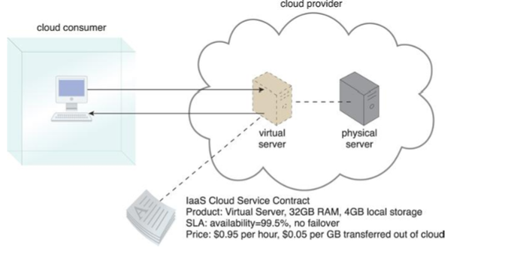
Cloud Delivery Models
Infrastructure-as-a-Service (Iaas)
Example: Google Apps, Microsoft Office 365, Salesforce

Slide 20
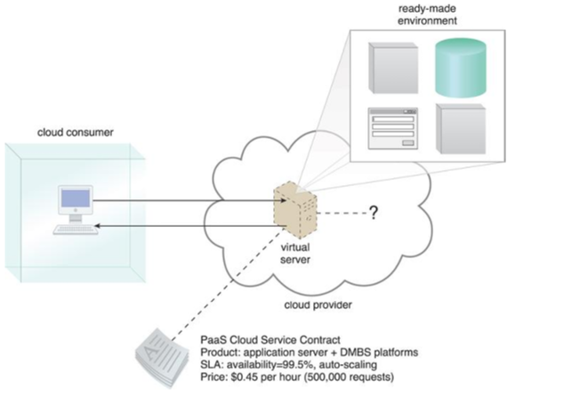
Platform-as-a-Service (PaaS)
Example: Google App Engine, Amazon Web Services(AWS), Elastic Beanstalk

Slide 21
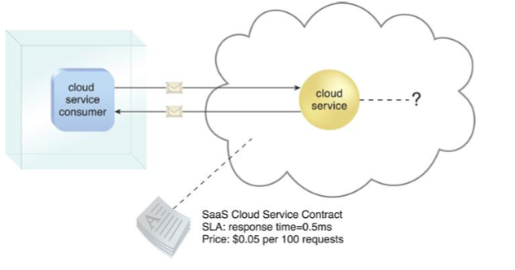
Software-as-a-Service (SaaS)
Example: Google Compute Engine, Microsoft Azure, AWS Elastic Compute Cloud

Slide 22
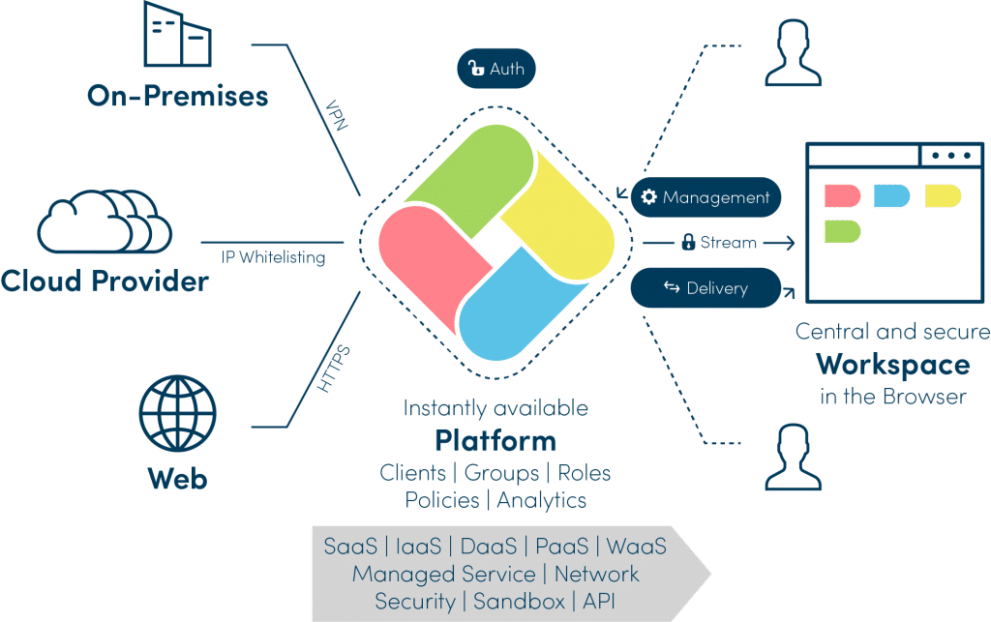
Anything-as-a-Service (Xaas) : https://kinsta.com/blog/xaas/

Slide 23
XaaS Examples:
Authentication as a Service (AaaS)
Containers as a Service (CaaS)
Database as a Service (DBaaS)
Device as a Service (DaaS)
Disaster Recovery as a Service (DRaaS)
Function as a Service (FaaS)
Malware as a Service (MaaS)
Network as a service (NaaS)
Storage as a Service (STaaS)
Unified Communications as a Service (UCaaS)

Slide 24
Benefits of XaaS
Cost saving
Scalability
Accessibility
Faster Implementation
Quick modification
Better security
Flexibility

Slide 25
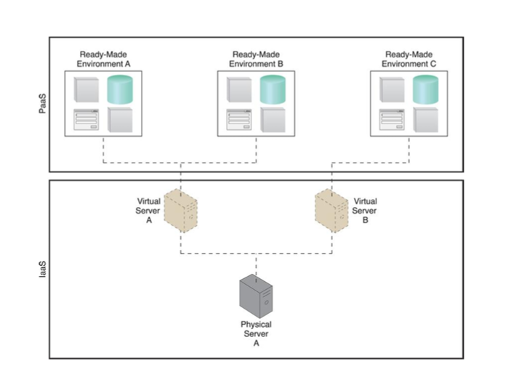
Combination of Cloud delivery models
IaaS+PaaS

Slide 26
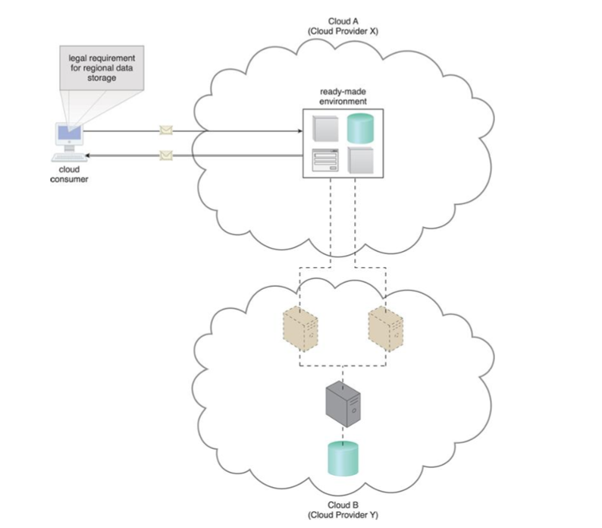
Example:

Slide 27
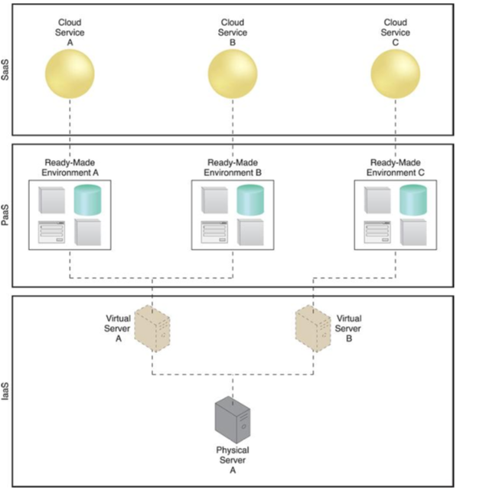
IaaS+PaaS+SaaS

Slide 28
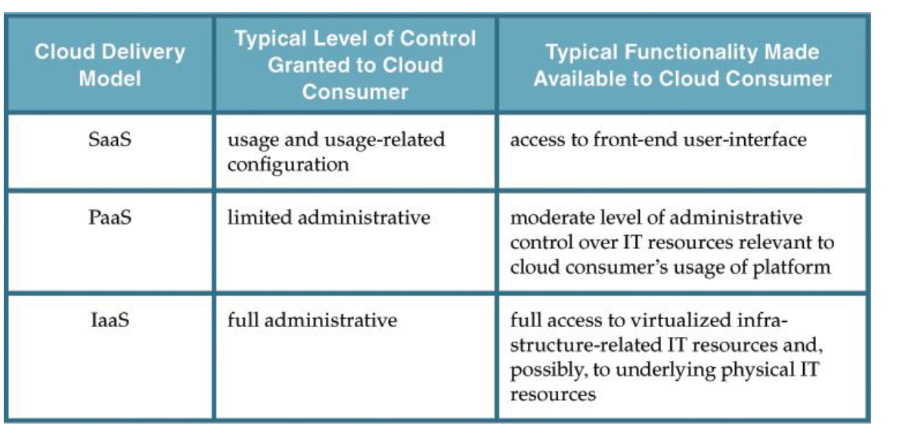
Comparison of Cloud Deployment Models

Slide 29
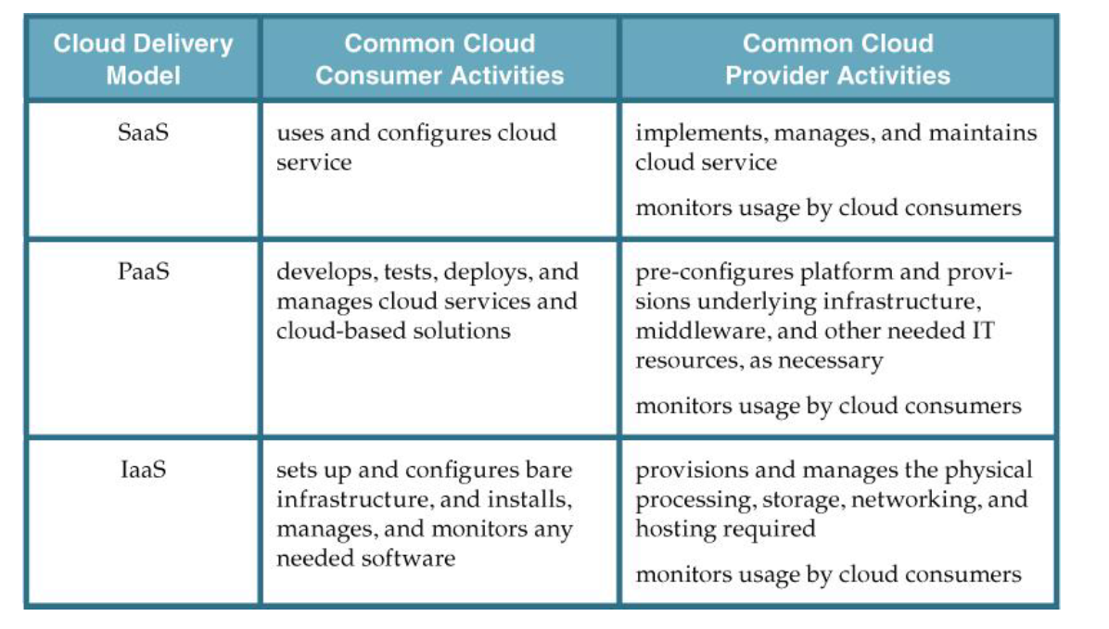
Activities carried out by Cloud Consumer and Provider

Slide 30
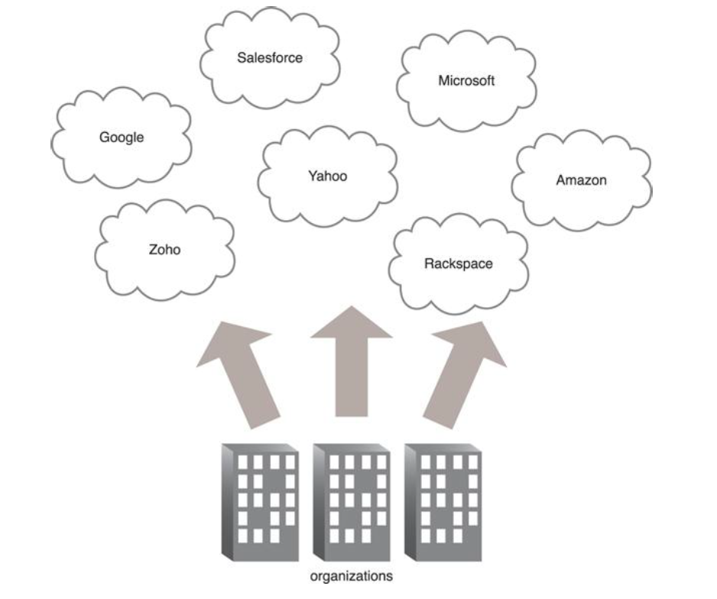
Cloud Deployment Models:
Public Cloud
Example: AWS, Azure, IBM, Oracle

Slide 31
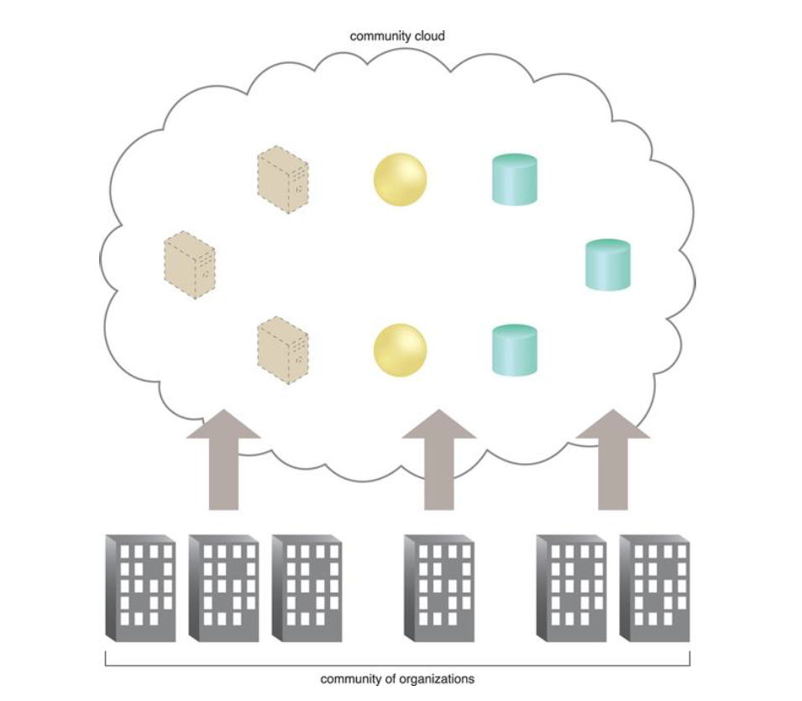
Community Cloud
Example: Banks, Insurance companies, Enterprises

Slide 32
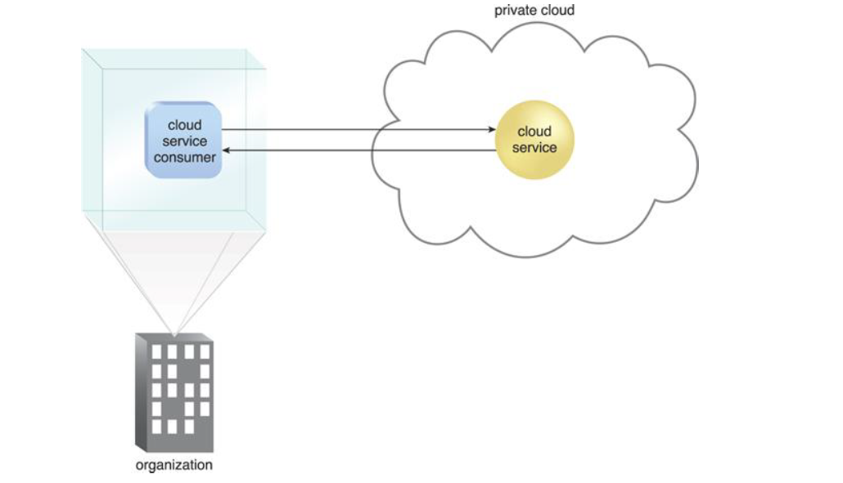
Private Cloud
Example: DELL, OpenStack, VMWare

Slide 33
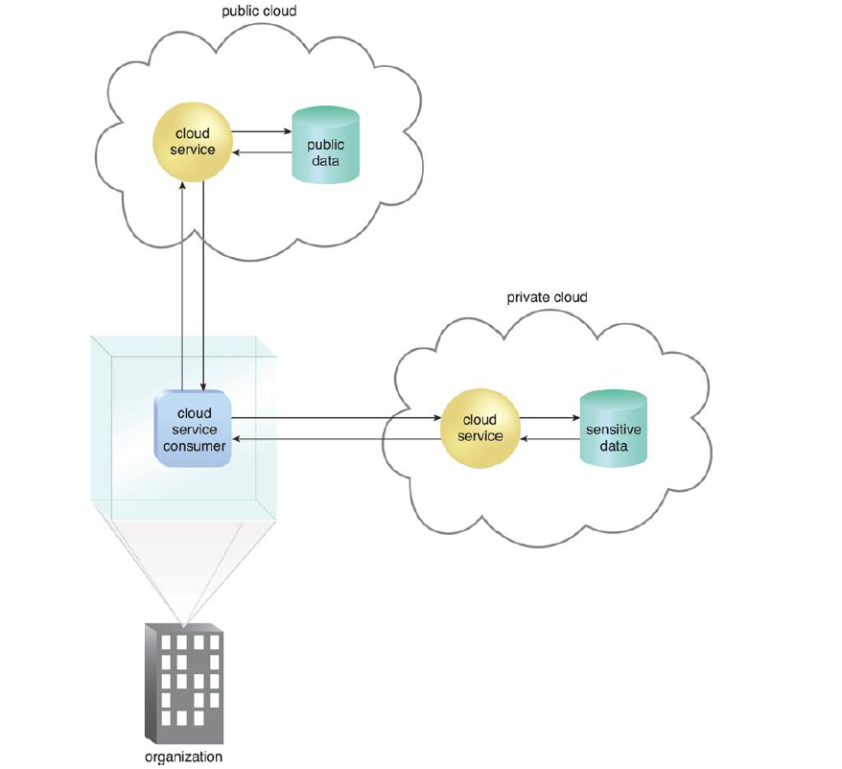
Hybrid Cloud
Example: Rackspace, VMWare, Cisco, IBM

Slide 34
Other Cloud Deployment Models:
Virtual Private Cloud – Also known as a “dedicated cloud” or “hosted cloud,” this model results in a self-contained cloud environment hosted and managed by a public cloud provider, and made available to a cloud consumer.
Inter-Cloud – This model is based on an architecture comprised of two or more inter-connected clouds.

Slide 35
Test Your Understandings
a) What type of computing technology refers to services and applications that typically run on a distributed network through virtualized resources?
Distributed Computing
Cloud Computing
Soft Computing
Parallel Computing
b) Which one of the following options can be considered as the Cloud?
Hadoop
Intranet
Web Applications
All of the mentioned
c) Which of the following has many features of that is now known as cloud computing?
Web Service
Softwares
All of the mentioned
Internet

Slide 36
d) How many types of services are there those are offered by the Cloud Computing to the users?
2
4
3
5
e) The Foce.com and windows Azure are examples of which of the following?
IaaS
PaaS
SaaS
Both A and B
f) Which one of the following a technology works behind the cloud computing platform?
Virtualization
SOA
Grid Computing
All of the above

